Slide 1
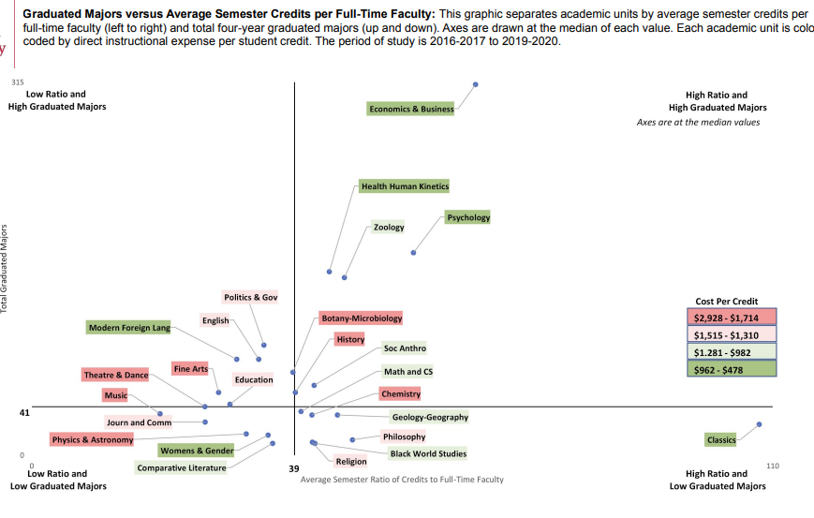
Graduated Majors v. Avg. Semester Credits per FT Fac.
Program_Grads
——————
program_id
student_id
grad_date
Grads_v_fac_load
——————
program_id
maj_grad_count
avg_sem_cred_fac
period
e-Services
Teaching_Load
——————
program_id
courseoffering_id
instructor_id
credits
term
Program_Costs
——————
program_id
direct_costs
Indirect_costs
period
Faculty_Costs
——————
person_id
salary
benefits
other
period
Grads_v_fac_load_w_cost
——————
program_id
maj_grad_count
avg_sem_cred_fac
program_cost
period
ADP/EBS/???
AAUP spreadsheets
EBS/???

